Slide 1


LOAN APPROVAL DATASET EDA Using SQL
BY SANDRA GANESHAN

Slide 2
Introduction
Overview of the Lending Industry
The lending industry plays a crucial role in personal finance, providing individuals with access to capital for various purposes, such as purchasing homes, funding education, or covering emergency expenses.
Lending practices significantly influence economic stability, affecting consumer spending and investment.
Significance of Lending
Access to Finance: Enables individuals to manage cash flow and invest in opportunities.
Economic Growth: Supports local businesses and boosts overall economic activity.
Risk Management: Helps lenders assess and mitigate financial risks associated with loan defaults.
Project Aim
The aim of this project is to conduct an exploratory data analysis (EDA) on a loan dataset to:
Identify trends and patterns in loan applications and approvals.
Assess the impact of various demographic and financial factors on loan outcomes.
Provide actionable insights to improve lending practices and decision-making processes.

Slide 3
Objectives
Key Objectives
Analyze Demographics
Examine the relationship between borrower demographics (age, gender, education) and loan approval rates.
Understand how these demographic factors influence loan amounts and purposes.
Income Analysis
Investigate the impact of borrower income on loan eligibility and approval status.
Identify trends in loan amounts relative to different income brackets.
Loan Purpose Examination
Categorize loans based on their intended purposes (e.g., education, home purchase, debt consolidation).
Assess how loan purpose affects approval rates and loan terms.
Amount Assessment
Analyze the distribution of loan amounts across different demographics and purposes.
Evaluate the correlation between loan amounts and approval likelihood.
Risk Factor Assessment
Identify key risk factors associated with loan defaults, such as credit score and employment history.
Develop insights to optimize lending practices and enhance decision-making processes.

Slide 4
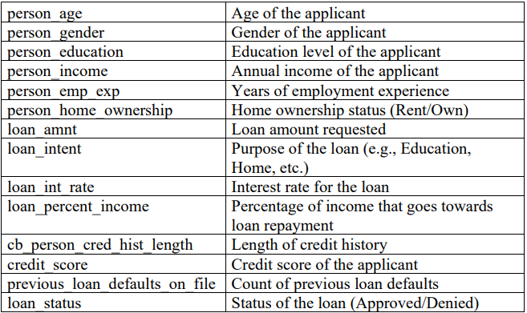
Data Overview
Dataset Structure:
• Total Rows: 45000

Slide 5
Data Cleaning & Preparation
Checked for Duplicates:
Ensured unique entries in the dataset to maintain data integrity.
Renamed Columns for Clarity:
Improved readability and understanding of the dataset by providing more descriptive column names.
Handled Null Values:
Identified and addressed missing data to avoid biases in analysis.
Outlier Management:
Addressed outliers, such as ages over 100, to maintain a realistic range for age-related analyses.

Slide 6
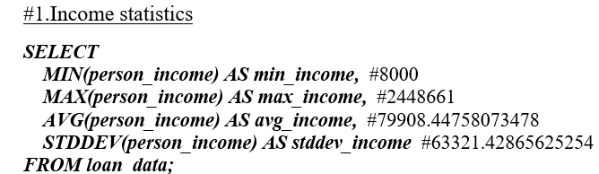
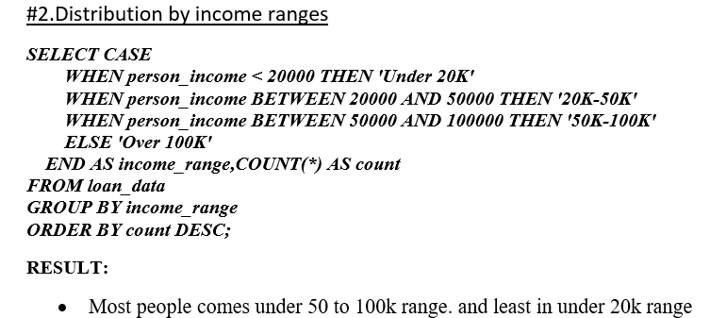
ANALYSIS

Slide 7
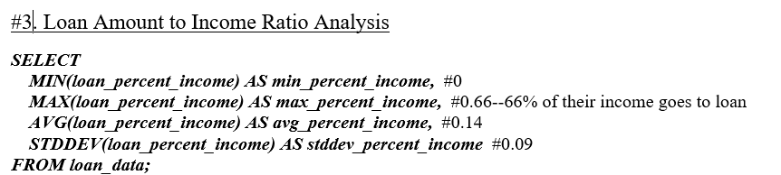
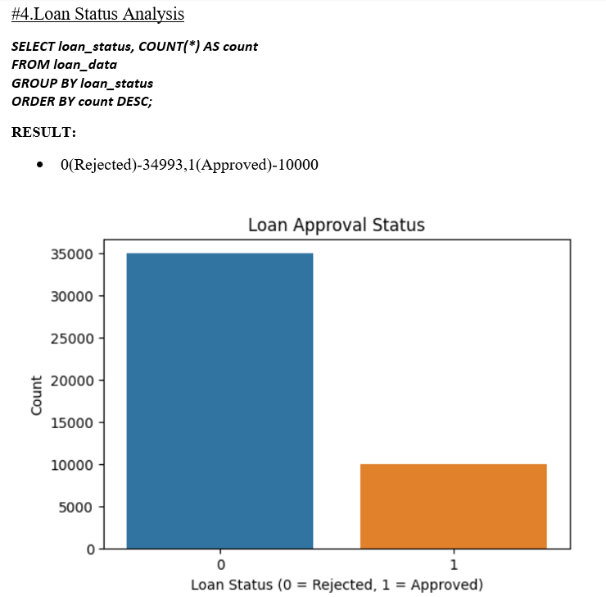

Slide 8
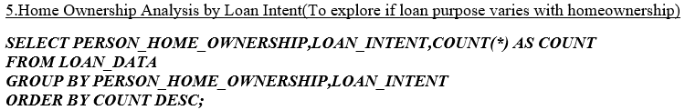
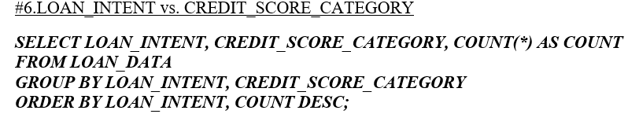
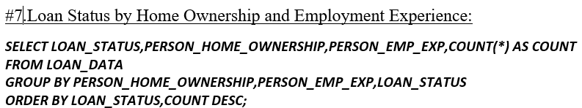

Slide 9
Conclusion
Summary of Insights
Enhanced Understanding: Analyzing applicant demographics, income levels, and loan purposes provides critical insights.
Strategic Advantage: Insights can be used to optimize lending strategies and better assess borrower risk.

